Slide 1
OPEN DATA AND
KNOWLEDGE GRAPHES
YUQIN ZHANG
JOSE MAX BARRIOS
DANIEL SEDANO
KATHERINE VIVANCO
NYC HOTSPOTS
Group 9

Slide 2
content
❖ Select Dataset
❖ Analyze Dataset
❖ Develop Ontology
❖ Data Linking
❖ Web Application
Notes:
According to the assignments that we have done so far, our presentation is going to be divided into five parts.

Slide 3
Select Dataset
Our dataset: NYC WI-FI HOTSPOT LOCATIONS
From: http//:www.Kaggle.com
which satisfies four requirements:
√ in the smart cities domain
√ available as a CSV file.
√ has an open license so it can be published.
√ can be easily linked with generic real-world entities
Notes:
In the first step, based on the following four requirements, we chose a dataset, which is New York City WI-FI Hotspot Locations. It Includes the data of WI-FI precise coordinates, postcodes, providers, cities, types, and activated dates.

Slide 4

Open License
§Publisher of dataset New York City Department of Information Technology & Telecommunications
§Rights holder License CC-O: Public Domain
§Potential license to be used for the dataset to be generated License CC-O: Public Domain
§Link to the license https://creativecommons.org/publicdomain/zero/1.0/
Notes:
Our goal is to eventually transform this data source into linked dataset, so in the next step, we made the analysis.
First, after analyzing license of the data source, we determined that we could use this dataset exactly as we wish.

Slide 5
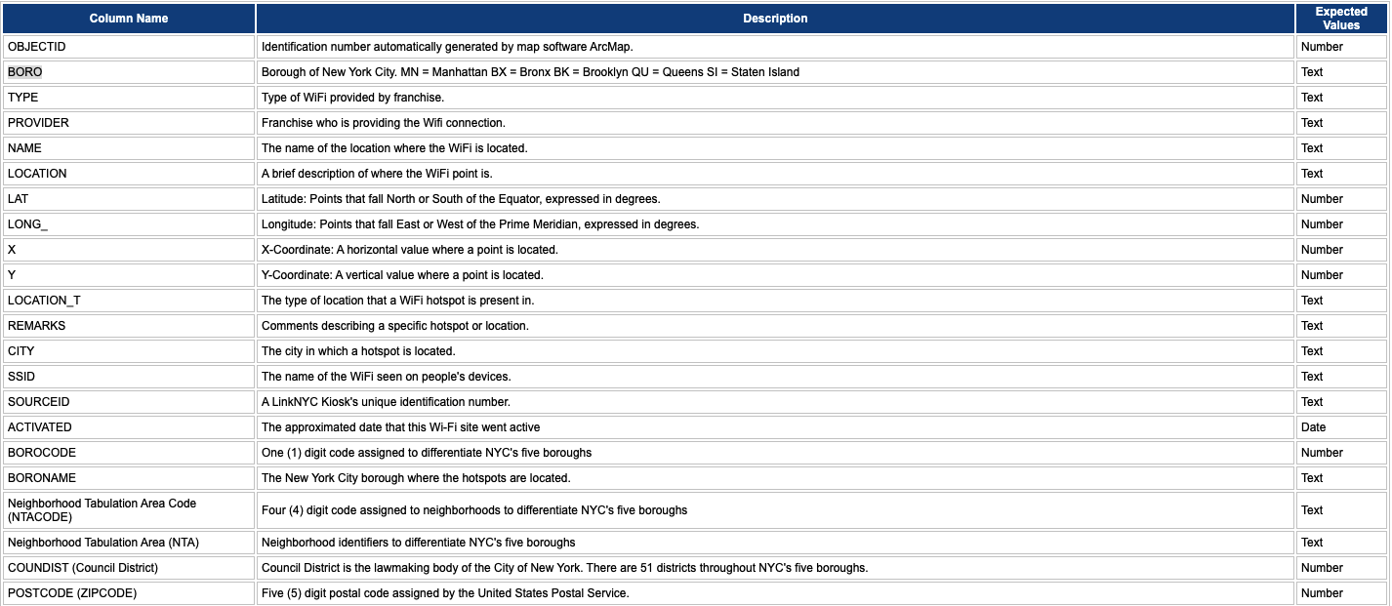
Analyze Dataset
Notes:
Then, we analyzed the dataset by identifying the content of each feature, giving the description to variables.
Original Dataset: 3205 observations and 21 features

Slide 6
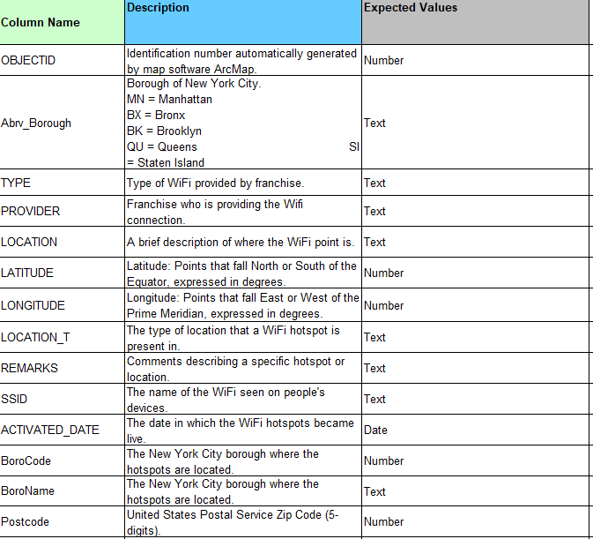
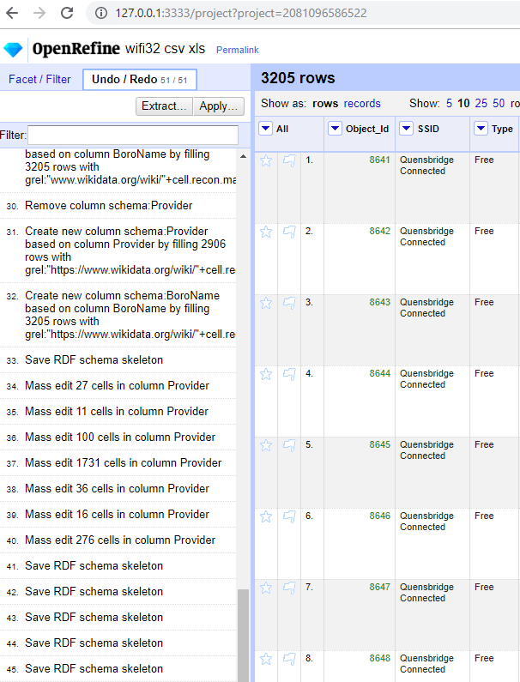
Data Cleaning
Notes:
Original Dataset: 3205 observations and 21 features
Dataset: 3205 observations and 14 features
Tool: OpenRefine

Slide 7
Naming Strategy
Domain
http://www.grupo09.upm.es/
Ontological term path:
http://www.grupo09.upm.es/new-york-hotspot#
Individual path:
http://www.grupo09.upm.es/new-york-hotspot
Ontological term pattern:
http://www.grupo09.upm.es/new-york-hotspot/ontology#
Individual pattern:
http://www.grupo09.upm.es/new-york-hotspot/resource_type/resource
Notes:
Before we started the step of developing ontology, we defined resource naming strategy.
THIS IS our uri for the individual pattern,
following the instructions in the course define path for ontogy and individuals and after we define the URI patterns also for bith terms
-hash for ontology
-slash for individuals
URIs define only a single ressource

Slide 8
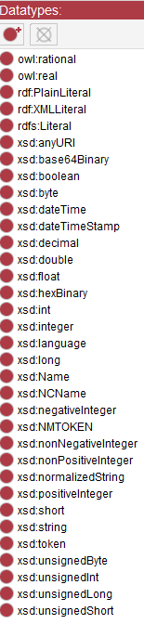
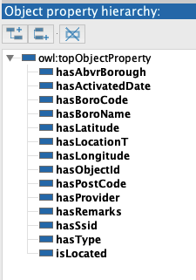
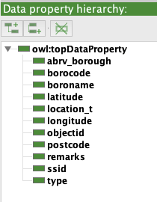
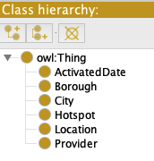
Ontology
Tool: Protégé

Slide 9
Ontology
Prefixes and Object Properties

Slide 10
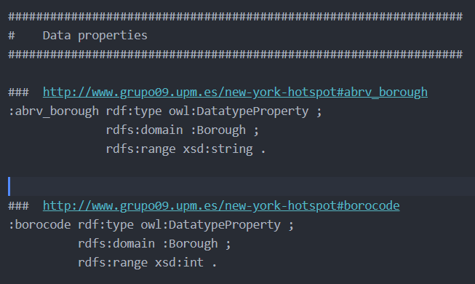
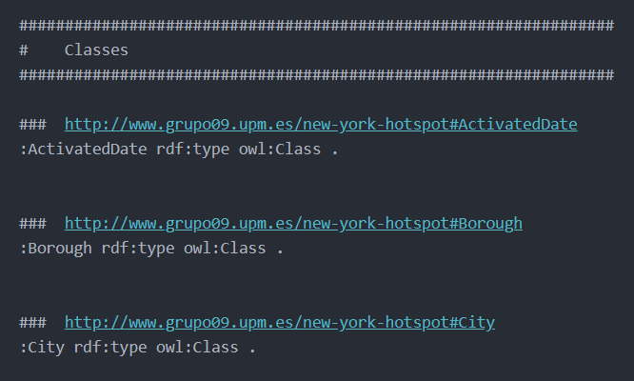
Ontology
Data Properties and Classes

Slide 11
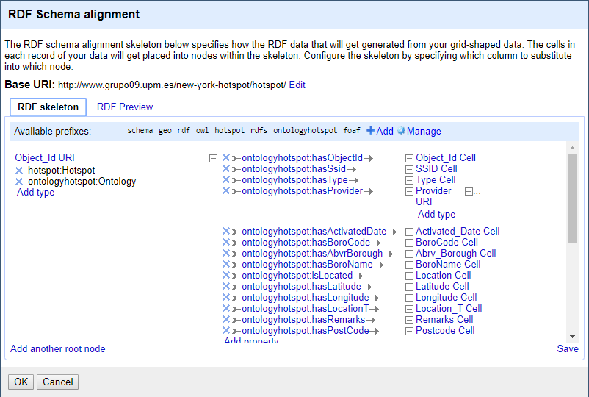
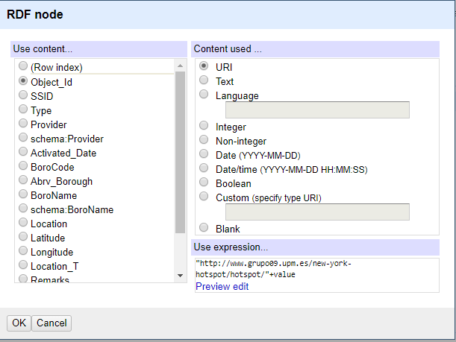
RDF Generation
Creating RDF skeleton

Slide 12
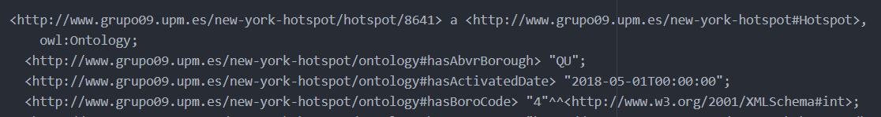
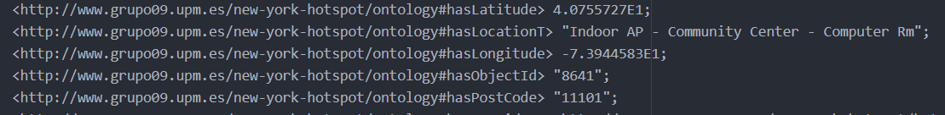
RDF Generation
RDF as Turtle Exportation

Slide 13
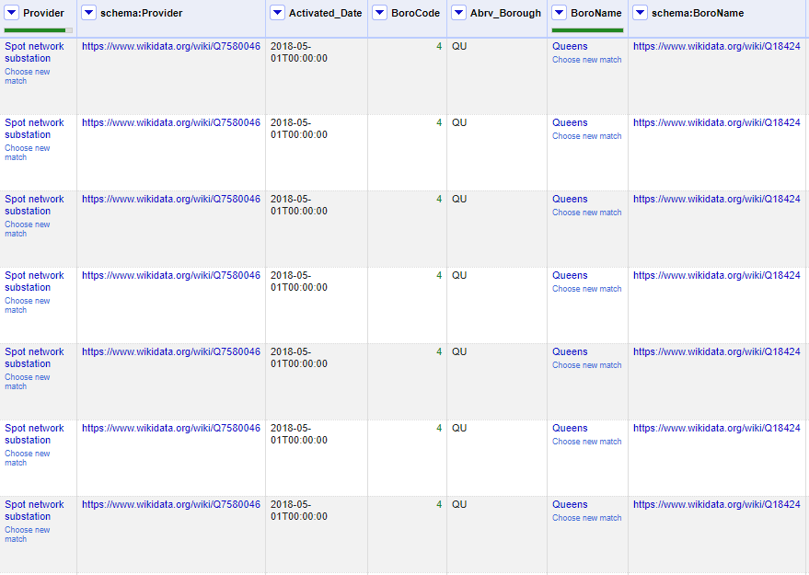
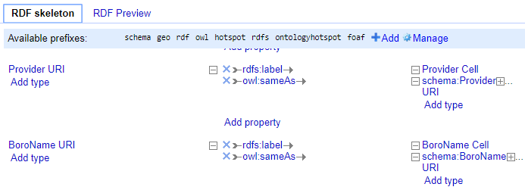
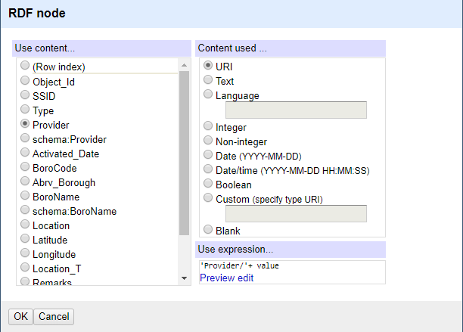
Data Linking

Slide 14
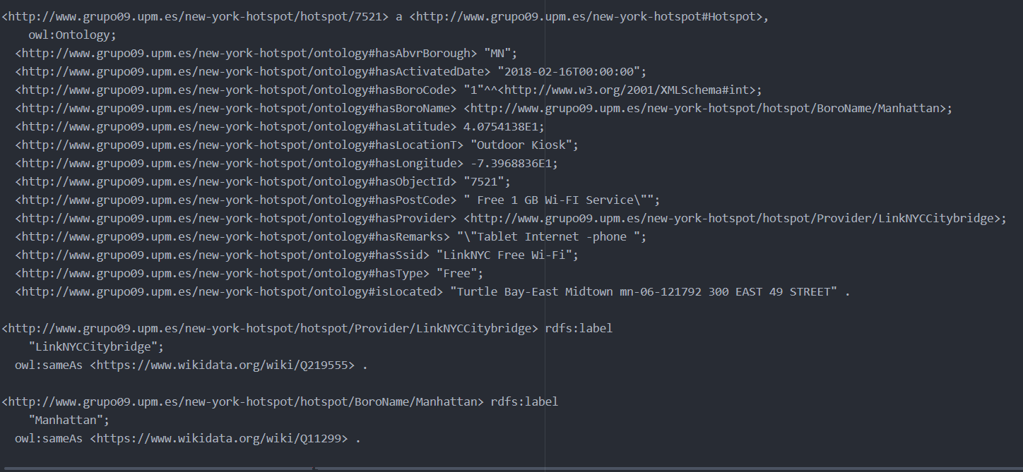
RDF Generation
RDF as Turtle Exportation

Slide 15
Application

